Slide 1
Predicting Collision Severity

Slide 2
Predicting Collision severity is valuable for the city of Seattle
Collisions cause massive destruction to life and property and can also cause a lot of traffic hindering movement from one place to another
Therefore ability to predict and reduce this would bring a lot of safety and value to the particular area.
Lives would be saved, money would be saved due to property not being destroyed and needing replacement and also individuals can get to their destinations on time.

Slide 3
Data Acquisition and Cleaning
All the data was acquired from the IBM data science specialization on Coursera, a link was provided to download the data.
In total 194673 rows and 38 columns
Unnecessary columns and rows missing data were dropped
Cleaned data contains 13 features

Slide 4
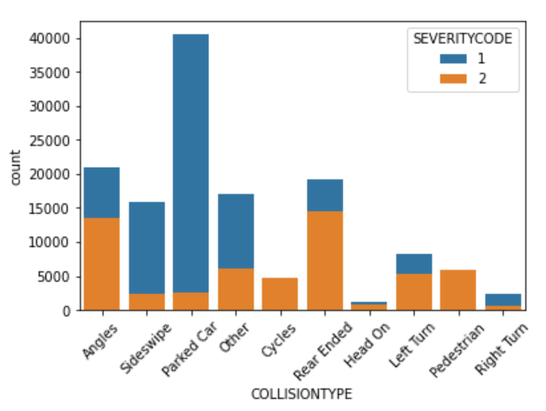
Parked cars were involved in the most collisions which might suggest people don’t park properly, so incoming cars tend to hit them or incoming cars use parked cars as safety net when they lose control so they don’t hit any passerby

Slide 5
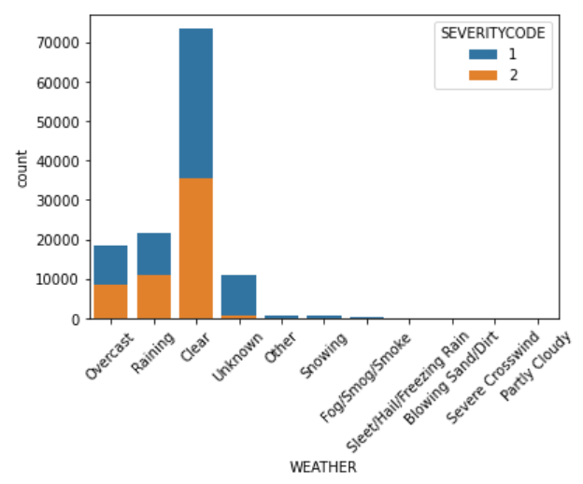
Surprisingly, majority of the accidents happened when the weather was clear, which shows bad weather didn’t have a major impact on collisions in the state of Seattle

Slide 6
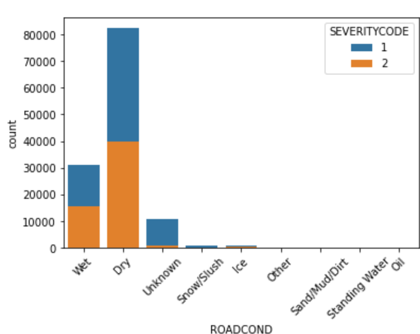
Suprisingly, Many of the accidents occurred on dry roads and not wet or icy or muddy road

Slide 7
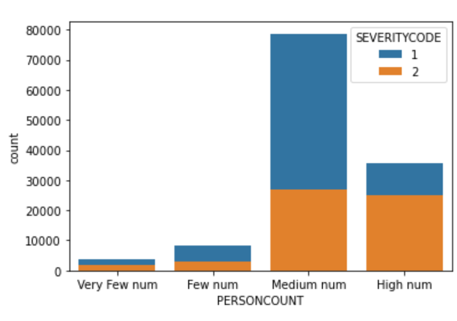
The number of people involved in most collisions were few with the greatest number of people being 2

Slide 8

Dealing with Unbalanced Datasets
Data was unbalanced with 1 having 70% of the samples
After over sampling both 1 and 2 have the same number of samples

Slide 9
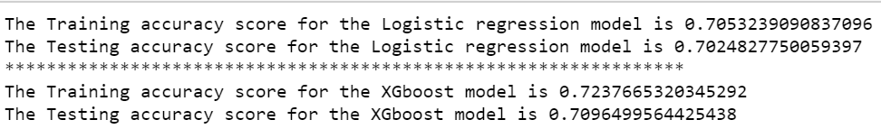
Model Performance
Accuracy:
Logistic 70.24%
Xgboost 70.96%

Slide 10
Conclusion
Built useful models to predict Collision Severity.
Accuracy of the models has room for improvement.

